Slide 1

ISEC3079 Penetration Testing Server Hardening
Christopher Jones
Adam Carroll
Jack Barrington
Tyler Schnurr

Slide 2
Server Installation
Windows Server 2016
Services Enabled:
Print and Document Services
Remote Desktop Services
Web Server (IIS)

Slide 3
Server Hardening
“DO NOT ENTER”

Slide 4
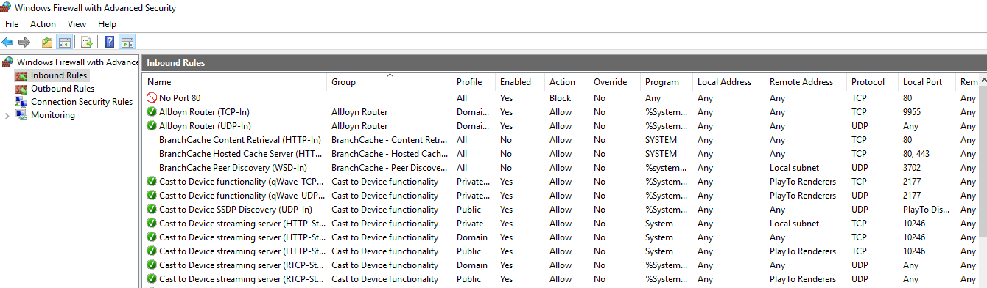
Block Port 80

Slide 5
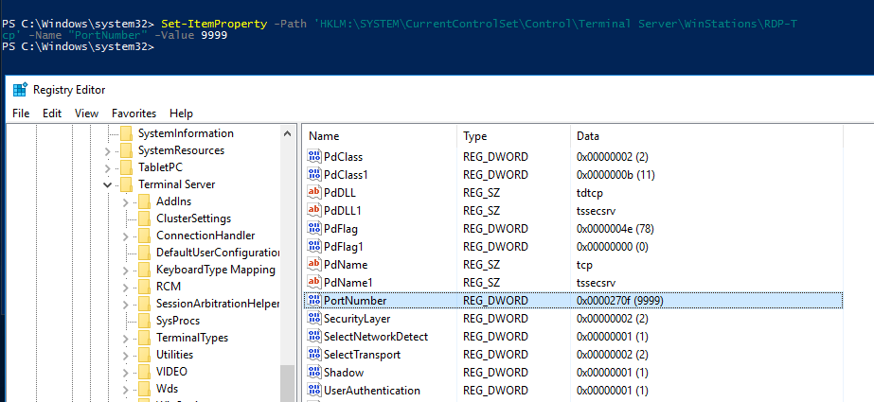
Change RDP Port to 9999

Slide 6
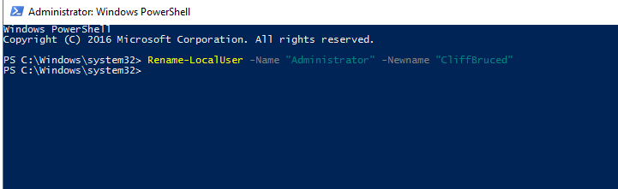
Change administrator Name

Slide 7
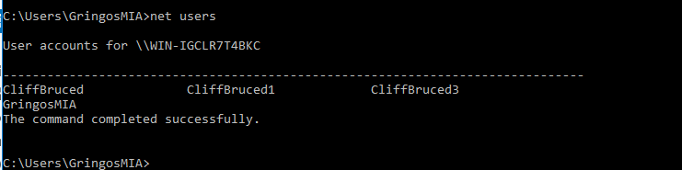
Change names of Default Accounts

Slide 8
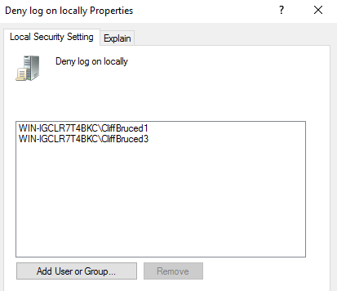
Deny Log On Locally for Default Accounts

Slide 9
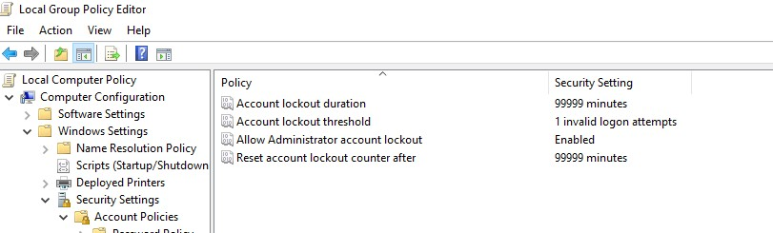
Secure Local Group Policy Settings

Slide 10
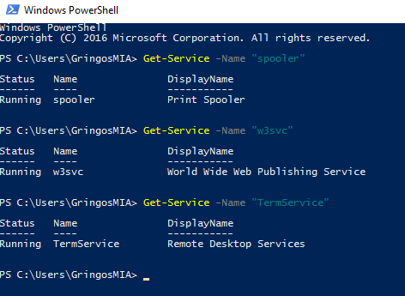
Confirm Running Services

Slide 11
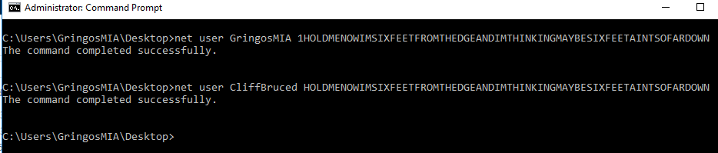
Set Secure Password

Slide 12
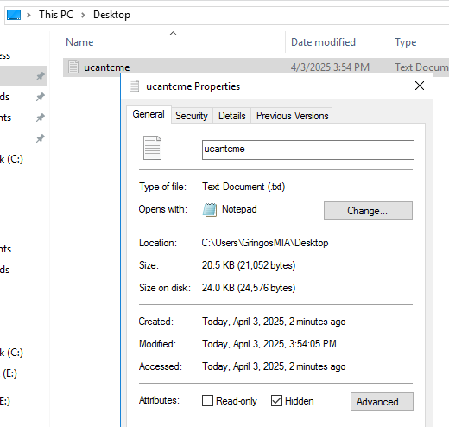
Hide Flag .txt File

Slide 13
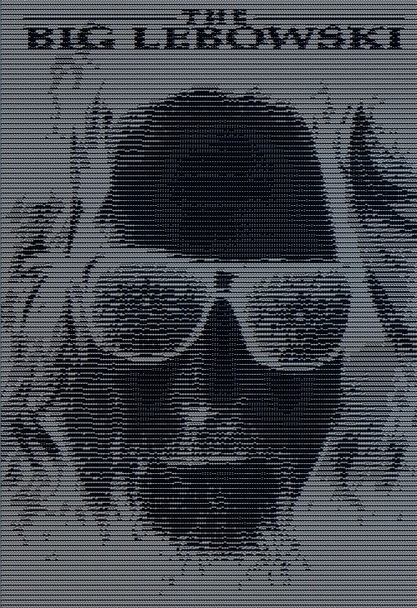
THE DUDE ABIDES
Our txt file contained the phrase
“THE DUDE ABIDES”,
accompanied by some sweet ascii art.

Slide 14

Server Hack
“I’M THE JUGGERNAUT …”

Slide 15
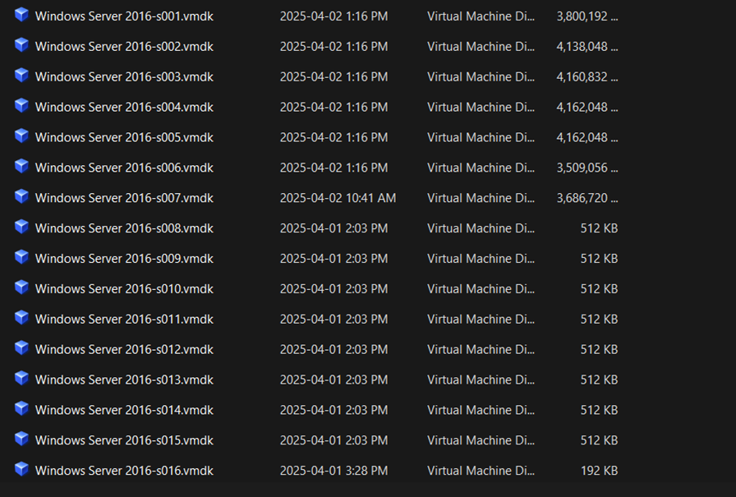
Gather All VM Disk Files

Slide 16
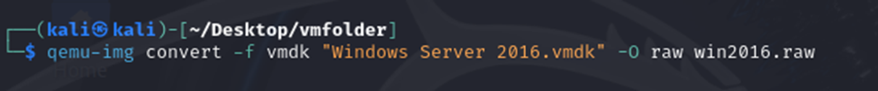
Convert VMDK to RAW Image

Slide 17
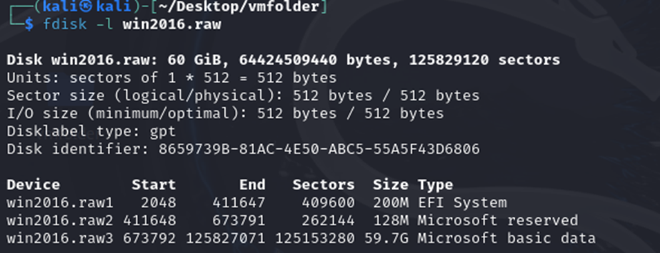
Analyze the Partition Layout

Slide 18
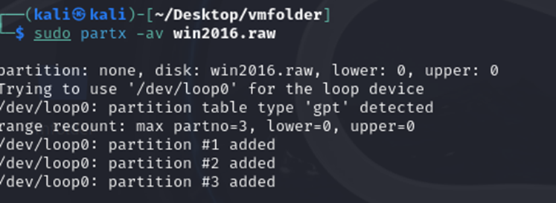
Use partx to Map Raw Partitions

Slide 19
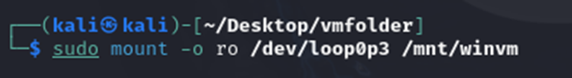
Mount the Windows Partition

Slide 20
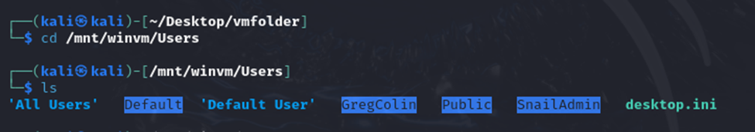
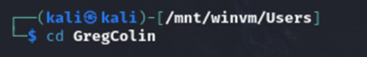
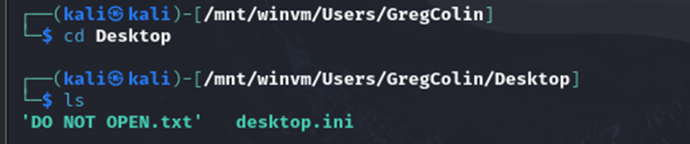
Locate the .txt File

Slide 21
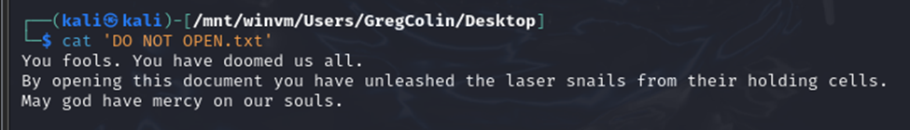
VICTORY

Slide 22
Questions?

